Slide 1
System Programming and
Compiler Construction
(Course Code - CE61)
Lecture #9
Dr. Anant V Nimkar PhD(CSE-IIT Kharagpur)
Associate Professor
Department of Computer Engineering
Sardar Patel Institute of Technology Mumbai

Slide 2
Basics of Parser and Grammar
Role of the Parser
Types of Parsers
Context-Free Grammar
Notational Conventions
Parse Trees & Derivations
Ambiguity
Lexical Vs Syntactic Analysis
Eliminating Ambiguity
Elimination of Left Recursion
Left Factoring

Slide 3
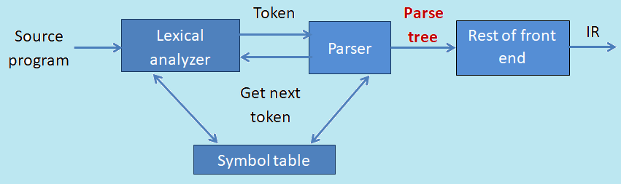
Role of the Parser
Parser obtains a string of token from the lexical analyzer and reports syntax error if any otherwise generates syntax tree. There are two types of parser:
  Top-down parser
  Bottom-up parser

Slide 4
Functions of Parser
performs context-free syntax analysis
guides context-sensitive analysis
constructs an intermediate representation
produces meaningful error messages
attempts error correction

Slide 5
Context Free Grammar
A Context Free Grammar is 4-tuple G=(V,T,P,S) where
  V is finite set of non-terminals
  Σ is disjoint finite set of terminals
  S is an element of V and it's a start symbol
  P is a finite set of formulas of the form A--> α where A is in V and α is in (V U Σ)*
e.g. G=({E,O},{+,-,*,/,^,id],E,{E → E O E, E →(E), E → id})

Slide 6
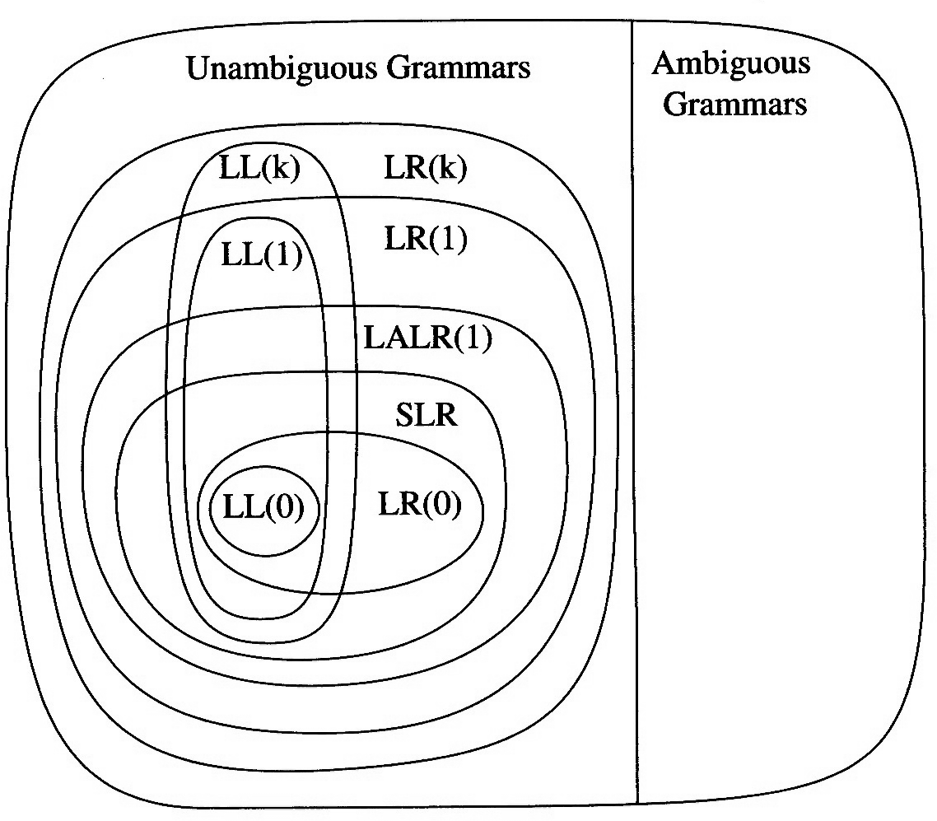
Hierarchy of grammar classes
LL(k):
  Left-to-right, Leftmost derivation, k tokens lookahead
LR(k):
  Left-to-right, Rightmost derivation, k tokens lookahead
SLR:
  Simple LR (uses “follow sets”)
LALR:
  LookAhead LR (uses “lookahead sets”)
http://en.wikipedia.org/wiki/LL_parser …

Slide 7
Notation and terminology
a, b, c, … ∈ T
A, B, C, … ∈ V
U, V, W, … ∈ V U T
α, β, γ, … ∈ (V U T)*
u, v, w, … ∈ T *
If A → γ then αAβ ⇒ αγβ is a single-step derivation using A → γ
⇒* and ⇒⁺ denote derivations of ≥0 and ≥1 steps
If S ⇒* β then β is said to be a sentential form of G
L(G) = { w ∈ T * ⏐ S ⇒⁺ w }, w in L(G) is called a sentence of G
L(G) = { β ∈ (V U T)* ⏐ S ⇒* β } ∩ T *

Slide 8
Derivation
At each step, we choose a non-terminal to replace.
  This choice can lead to different derivations.
Two strategies are especially interesting:
  Leftmost derivation: replace the leftmost non-terminal at each step
  Rightmost derivation: replace the rightmost non-terminal at each step

Slide 9
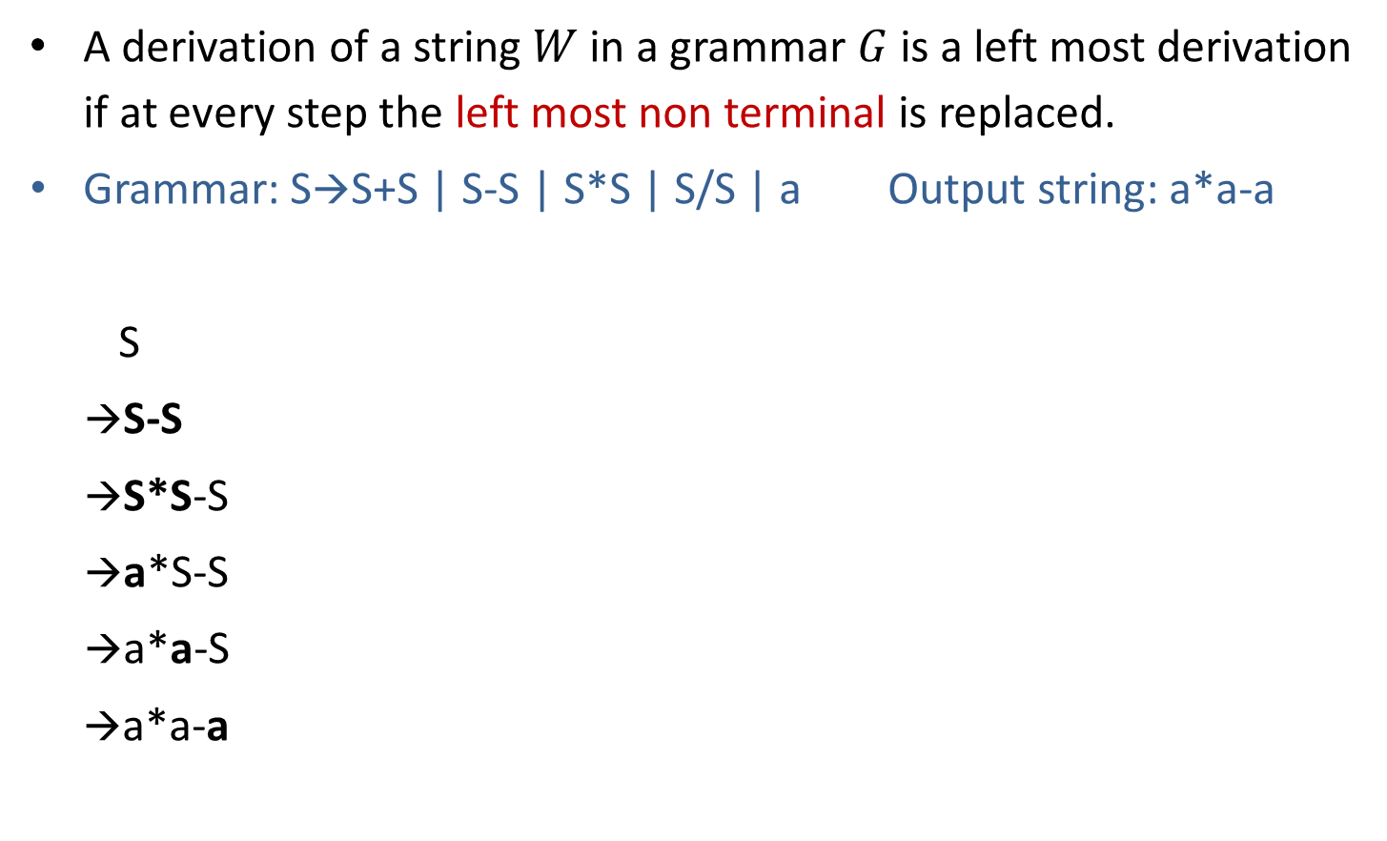
Leftmost derivation
S
Parse tree represents the structure of derivation
S
-
S
S
*
S
a
a
a
Leftmost Derivation

Slide 10
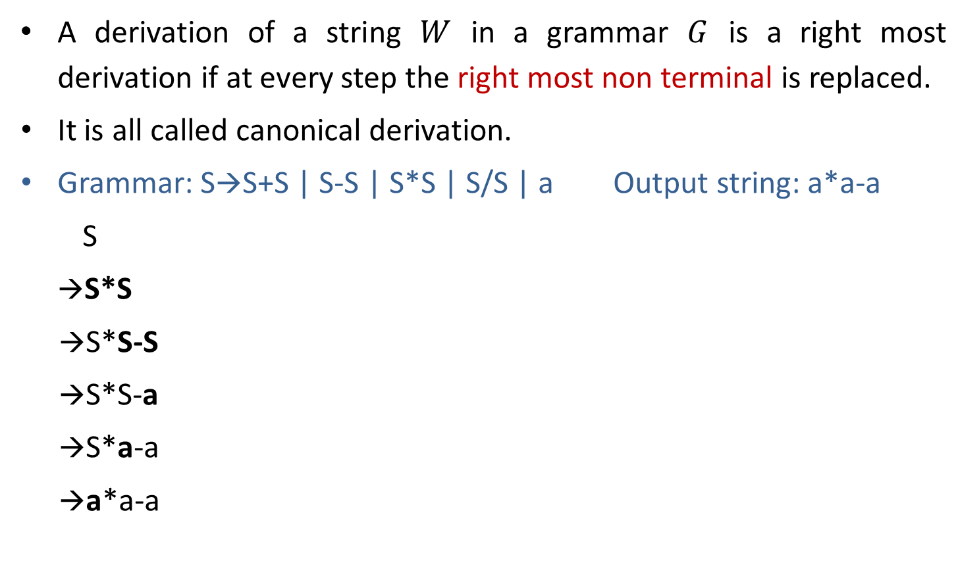
Rightmost Derivation
S
S
*
S
a
S
-
S
a
a
Parse Tree
Rightmost Derivation

Slide 11
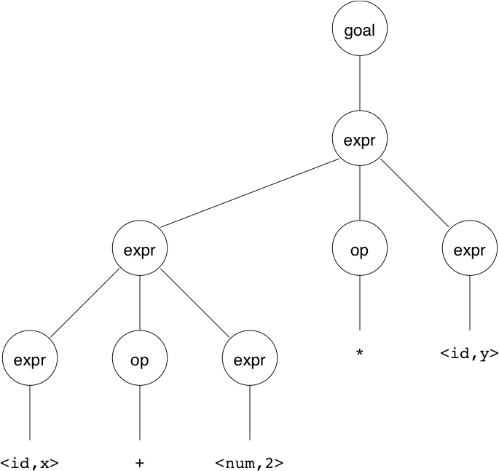
Precedence
Treewalk evaluation computes: (x+2)*y
Should be: x+(2*y)

Slide 12
Adding Precedence
Our grammar has a problem: it has no notion of precedence, or implied order of evaluation.
To add precedence takes additional machinery:
  <goal> ::= <expr>
  <expr> ::= <expr> + <term>
  | <expr> - <term>
  | <term>
  <term> ::= <term> * <factor>
  | <term> / <factor>
  | <factor>
  <factor> ::= num
  | id

Slide 13
Ambiguous grammar
Ambiguous grammar produces more than one leftmost or more thn one rightmost derivation for the same sentence.
Grammar: S→S+S | S*S | (S) | a Output string: a+a*a
→ S →S
→S*S →S+S
→S+S*S →a+S
→a+S*S →a+S*S
→a+a*S →a+a*S
→a+a*a →a+a*a
Here, Two leftmost derivation for string a+a*a is possible hence, above grammar is ambiguous.
S
S
S
*
S
S
+
S
S
+
S
a
a
S
*
S
a
a
a
a

Slide 14
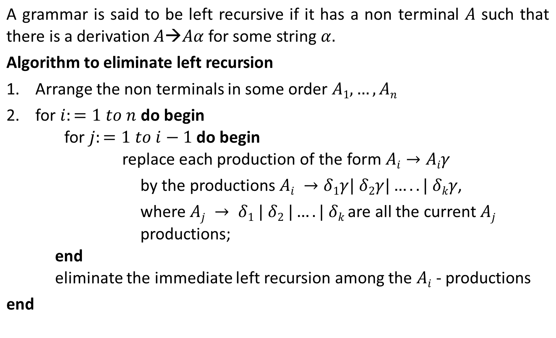
Left Recursion

Slide 15
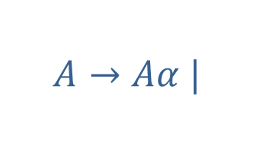







Left recursion elimination

Slide 16
Left recursion elimination
E→E+T | T
E→TE’
E’→+TE’ | ε
T→T*F | F
T→FT’
T’→*FT’ | ε
X→X%Y | Z
X→ZX’
X’→%YX’ | ε

Slide 17
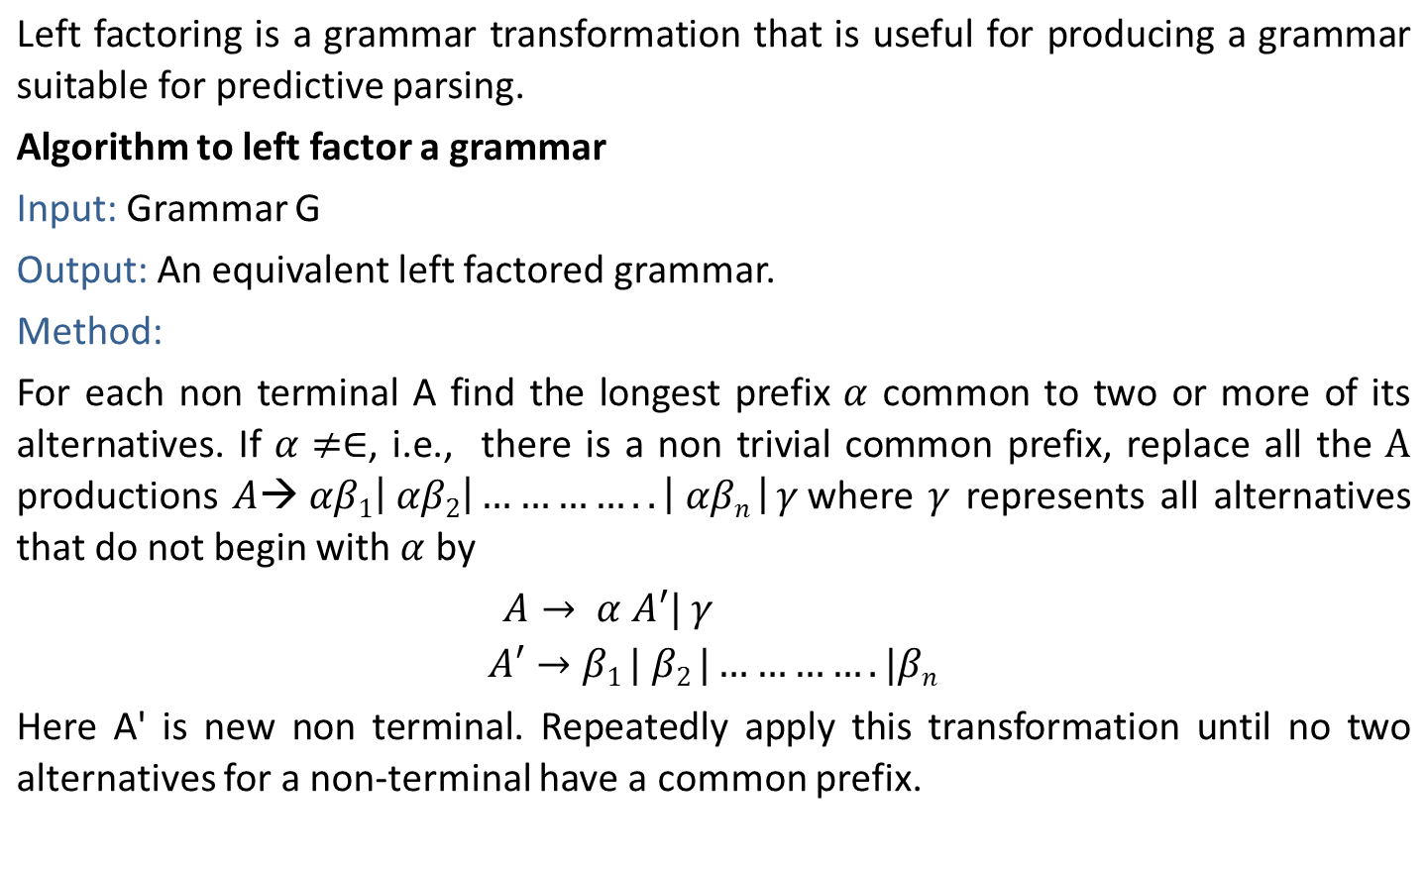
Left factoring

Slide 18
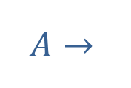
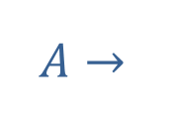
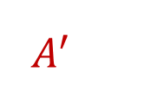






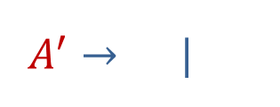
Left factoring
|
δ
δ

Slide 19
Left factoring
S→aAB | aCD
S→aS’
S’→AB | CD
A→ xByA | xByAzA | a
A→ xByAA’ | a
A’→ Є | zA
A→ aAB | aA |a
A→aA’
A’→AB | A | 𝜖
A’→AA’’ | 𝜖
A’’→B | 𝜖

Slide 20


